Slide 1
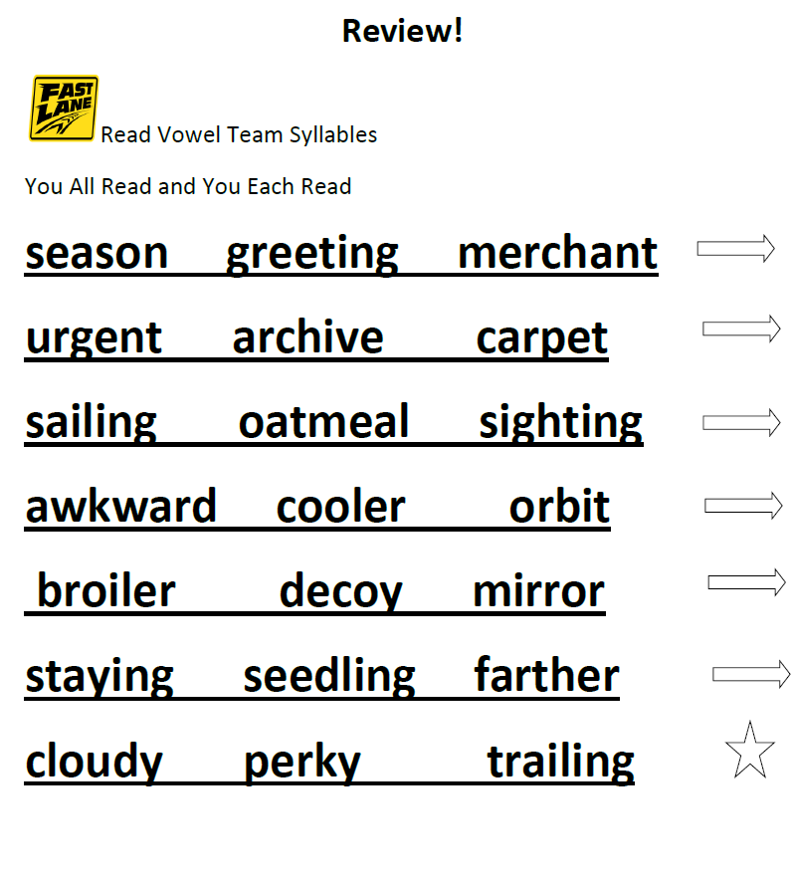
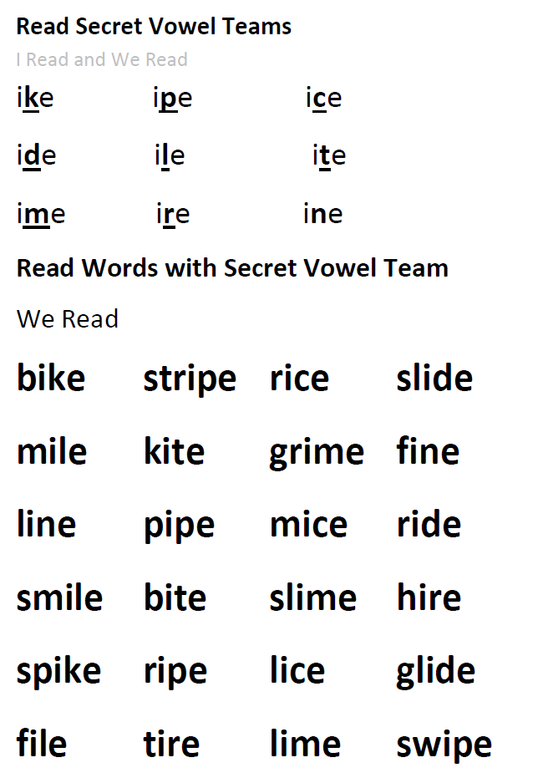
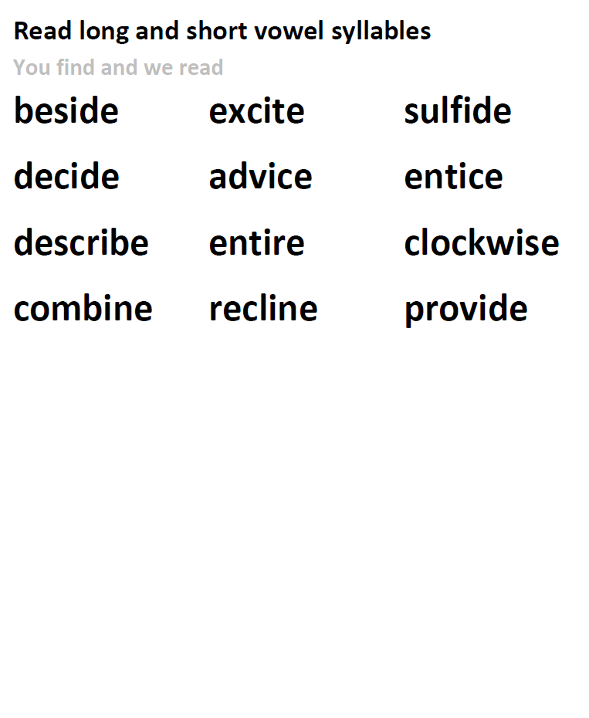
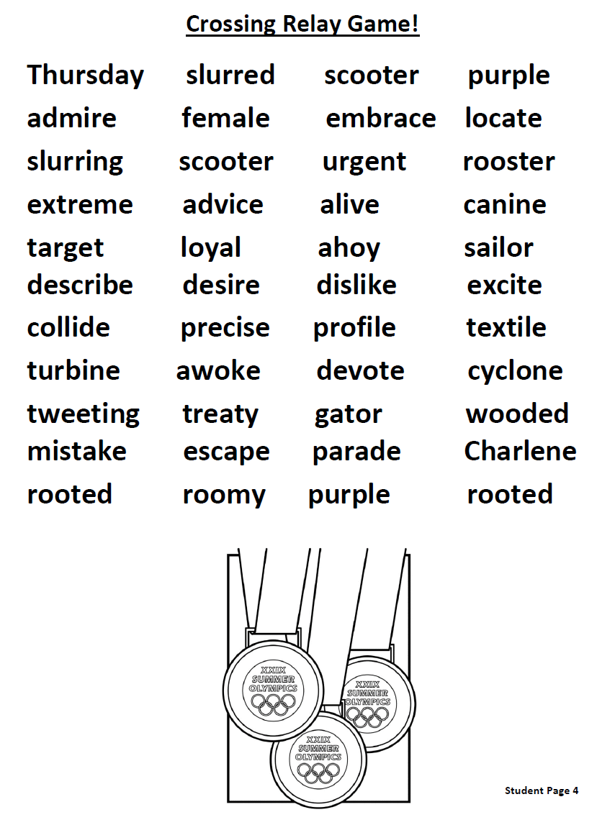
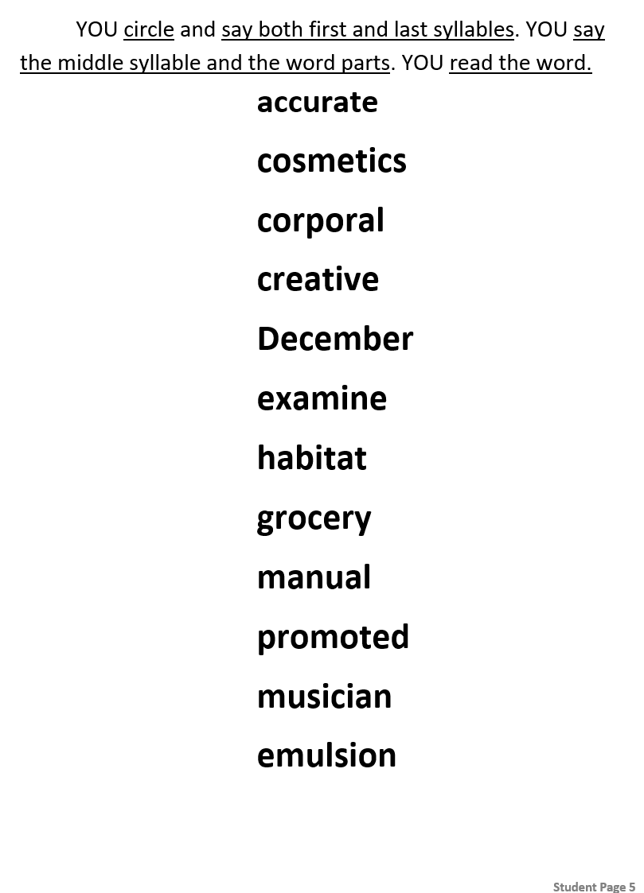
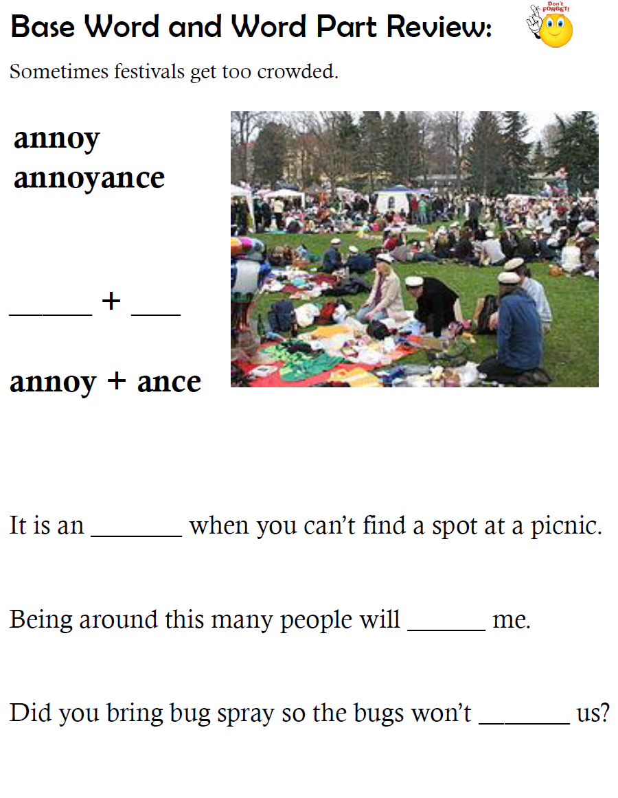
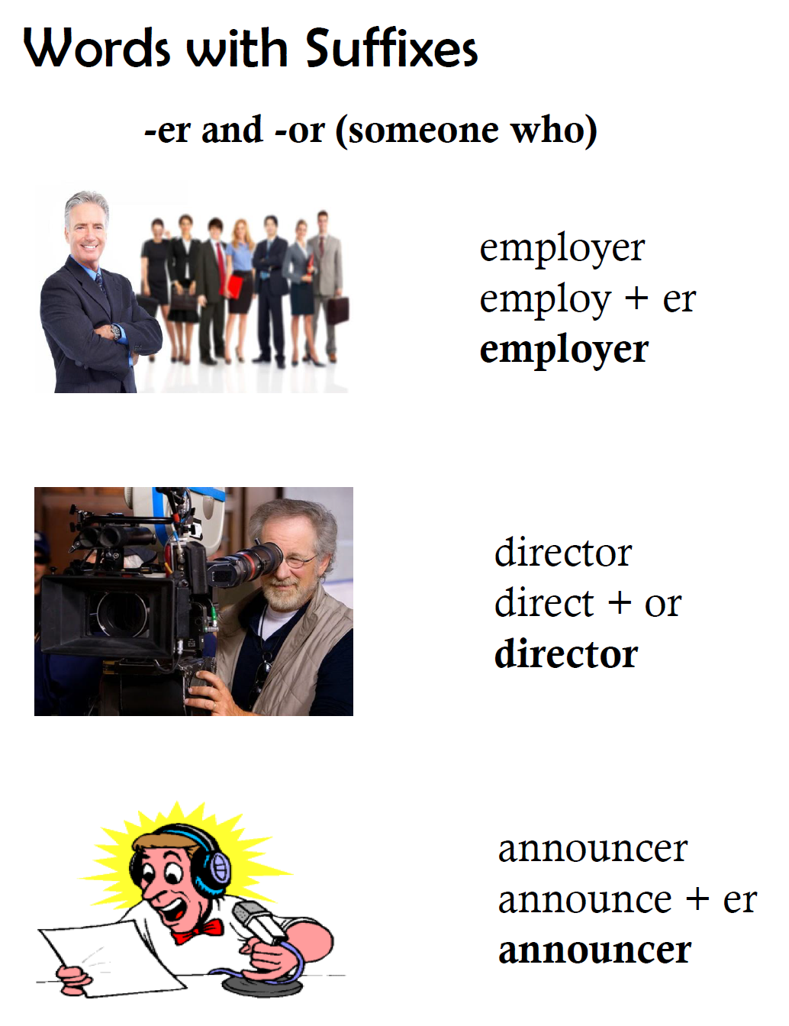
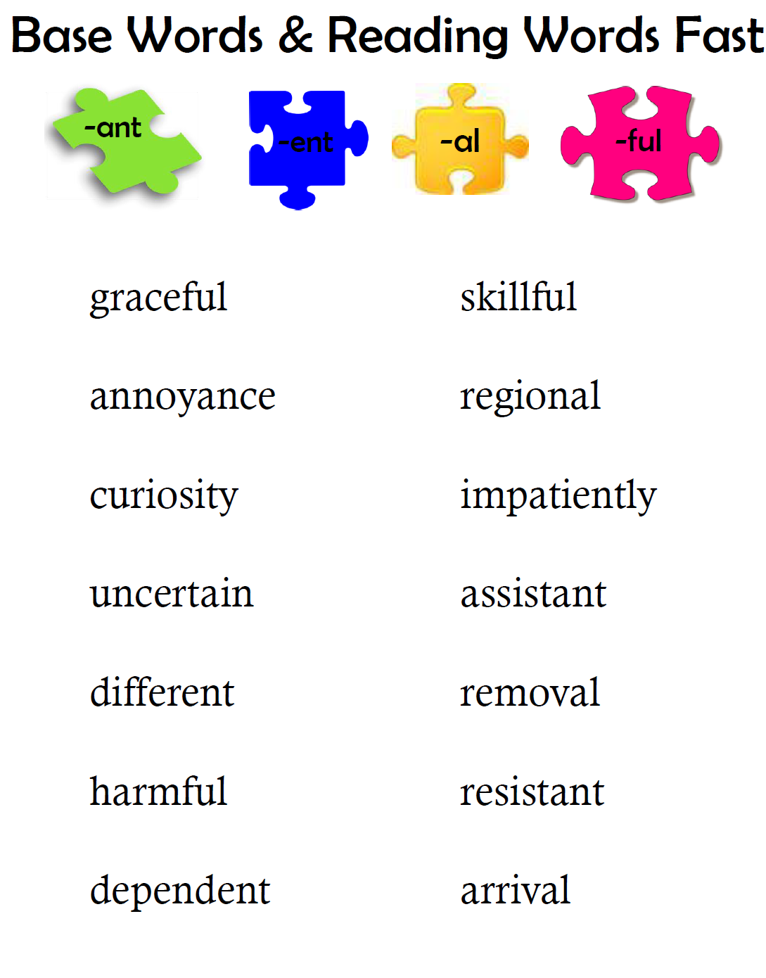
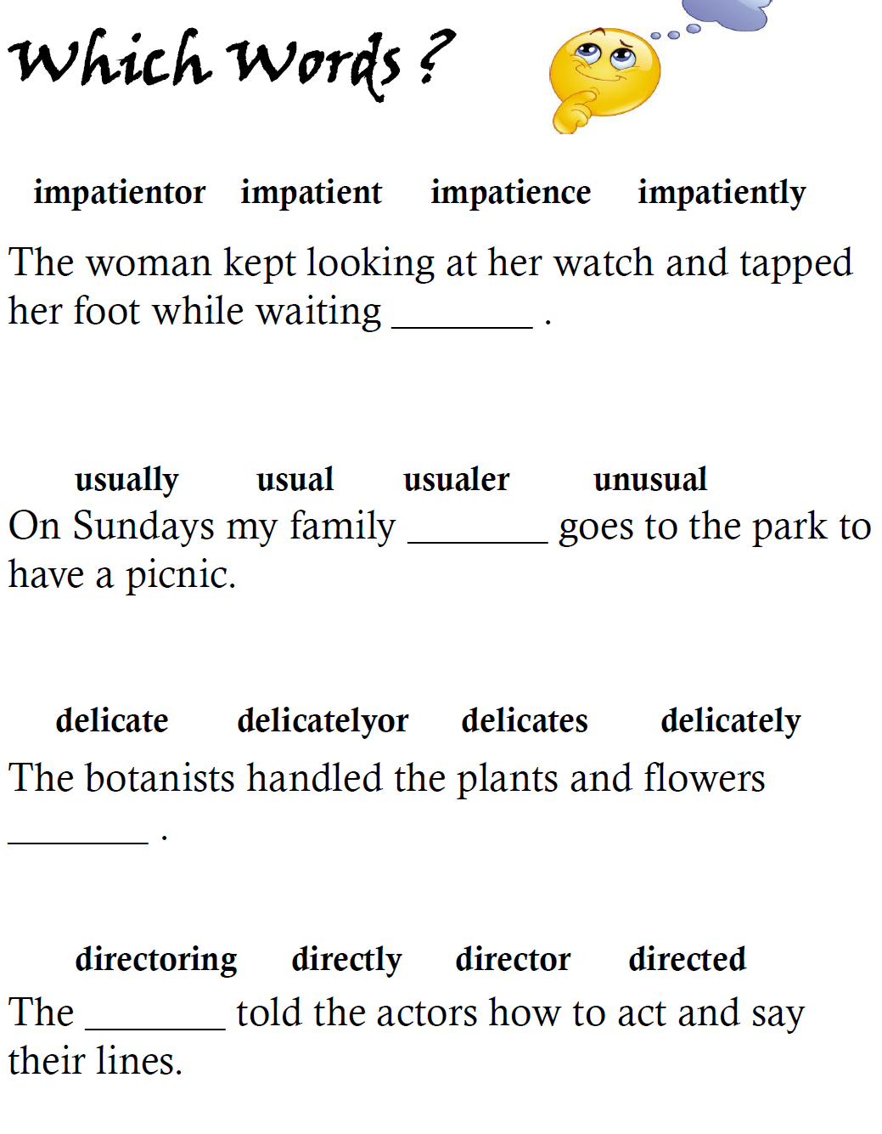
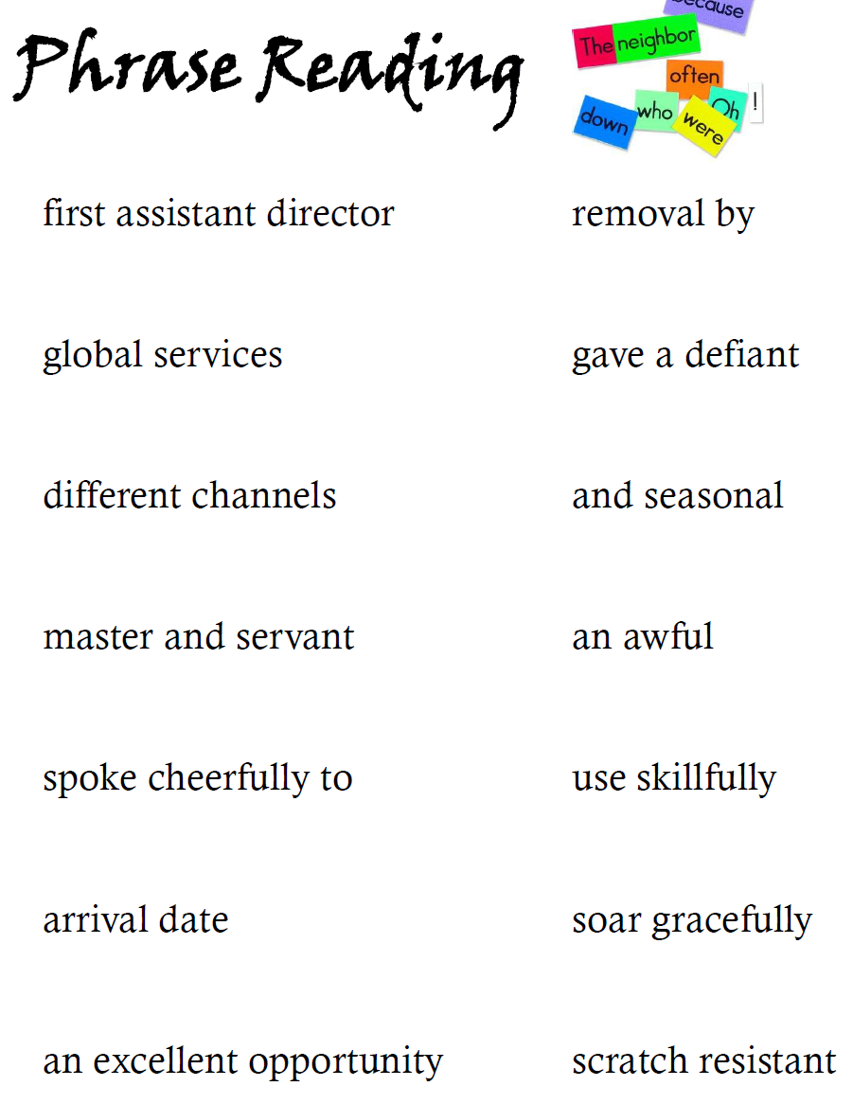
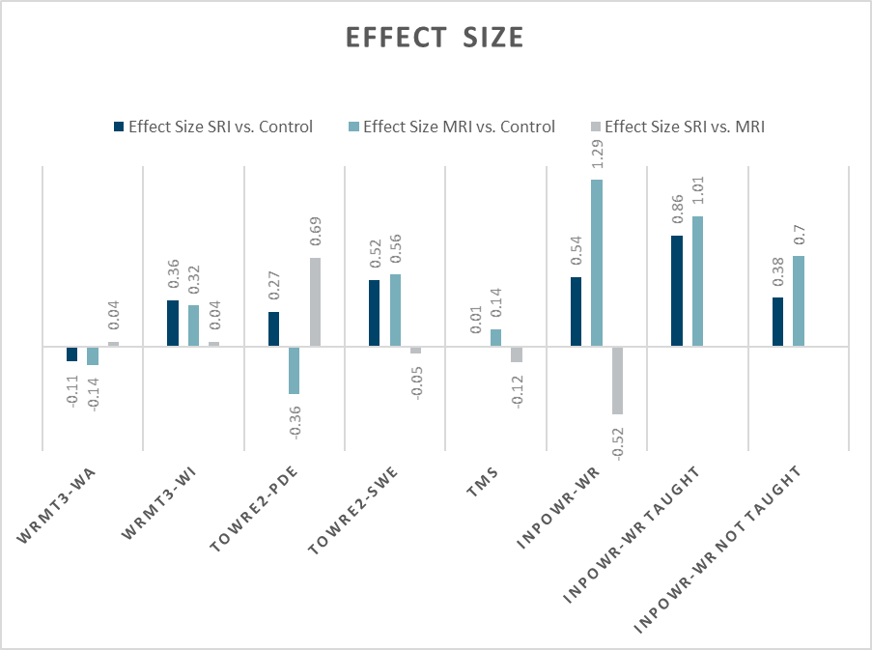
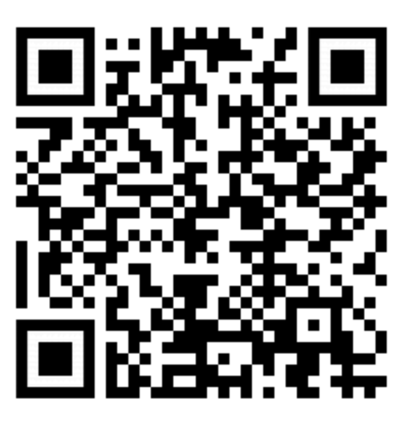
Semantic Knowledge in Polysyllabic Word Reading: An RCT for a Novel Morpheme Reading Intervention
Victoria M. Whaley Devin M. Kearns
INTRODUCTION
METHOD
Participants:
3rd and 4th grade children
Word Reading, decoding or fluency scores 10th-35th percentile
Random block assignment within schools
Conditions:
2 intervention conditions
Business as usual comparison group
All participants assessed pre and post intervention
DISCUSSION
Polysyllabic words have increasing importance and frequency in texts for older readers (Hiebert, Martin, & Menon, 2005) and present significant reading challenges.
Many popular, commercially available interventions for individuals with dyslexia emphasize instruction in syllable types and rules for syllable division. These may treat syllables as primarily useful for decoding words, but provide minimal information regarding meaning. Instruction may include very rare words or non-words for which students have no lexical representation. However, correlational studies support the value of semantic and morphological knowledge in decoding words (Kearns & Al Ghanem, 2019) and the potential value of introducing morphemes in early literacy instruction (Carlisle & Kearns, 2017) individuals with dyslexia. Since morphemes contribute to both phonological and semantic features of a word, they are well suited to illustrate the effects of semantic information.
We did a small randomized control trial to test the effects of the Morpheme Reading Intervention. Did it work?
Yes. Students in Morpheme RI improved more on word reading tests vs. Control and vs. Syllable RI—on standardized and researcher-created tests.
What makes this valuable?
The intervention was short, but it worked. The strategies might be efficient.
The components were unique, but it worked. Novel parts of Morpheme RI might add value to new and existing interventions.
Syllable Reading Intervention
Morpheme Reading Intervention
Review previously taught patterns
Practice reading words to improve fluency
Introduce new pattern
Read syllables with pattern
Read real and non- words with pattern
Read two syllable words with new pattern Practice syllable division
Integrate all concepts
Practice via games
Simple rules
Repeated readings
Strategy for three syllable words
Reading three syllable words
Review previous content
Contrast base words and derivatives
Provide context and meaning
Introduce new affixes
Provide brief definition
Provide multiple examples with images
Practice pronouncing affix and derivative
Practice pronouncing the affixes
Practice reading derivatives in isolation with fluency
Examples and non-examples of generating derivatives
Context for application of affix
Frequent phrases with derivative from google
Practice applying the derivative in context
Practice fluent reading
Participants (n=21) received 25 sessions of 30 minutes each of scripted intervention, aligned with the principles of direct instruction.
Instruction emphasized pronunciation, used real and non-words and provided no context or semantic information regarding any word taught.
Participants (n=20) received 25 sessions of 30 minutes each of scripted intervention, aligned with the principles of direct instruction.
Instruction morphemes and provided extensive context, including images, sentences and phrases to reinforce words and parts taught.
11
RESULTS
PURPOSE
LIMITATIONS
Test of Morphological Structure (TMS)
Identifying correct suffixes for real and non-words
α = .81
Control (n=20)
MD= 4.10 SD=4.25
MRI (n=15)
MD= 3.53 SD=3.56
SRI (n=18)
MD=3.67 SD=3.27
WRMT Word Attack Subtest (WRMT-WA)
Participants read single non-words
α = .89
Control (n=20)
MD= 4.10 SD=4.25
MRI (n=15)
MD= 3.53 SD=3.56
SRI (n=18)
MD=3.67 SD=3.27
This pilot study assesses the value of morphemes and semantic knowledge in polysyllabic word reading interventions. We contrast literacy outcomes for participants who received an intervention focused on morphemes, heavy in semantic information with an intervention focused on syllable pronunciation devoid of semantic knowledge, and those who received no additional intervention.
Our questions are:
Do interventions focused on morphemes improve student word reading ability? Does this improvement extend to words that were not directly taught?
Do morpheme focused interventions provide greater reading improvement than those focused on just pronunciation?
Farm. My uncle is a ____.
*
Small sample size limits generalizability
Brevity of intervention complicates distinguishing differences between intervention groups and control
Unclear whether business as usual instruction was similar in all school sites.
Farm. My uncle is a …
TOWRE Sight Word Efficiency (SWE)
Participant reads as many words as possible in 45 seconds
Control (n=20)
MD= 2.85 SD=9.24
MRI (n=15)
MD= 7.20 SD=5.28
SRI (n=18)
MD=6.97 SD=5.81
*
*
*
*
*
Farmer.
INPoWR Specific Word Reading Task
(INPOWR-WR)
Researcher created
89 polysyllabic words
29 taught in MRI
30 taught in SRI
30 four syllable words
Not taught
Effect size calculated for entire assessment and for subsets of words, taught and not taught in each intervention
α = .95
Control (n=20)
MD= 4.10 SD=4.25
MRI (n=15)
MD= 3.53 SD=3.56
SRI (n=18)
MD=3.67 SD=3.27
REFERENCES
Test of Word Reading Efficiency, 2nd edition (TOWRE)
Phonemic Decoding Efficiency (PDE)
Participant reads as many non-words as possible in 45 seconds
Control (n=20)
MD= 6.35 SD=6.32
MRI (n=15)
MD= 4.13 SD=5.89
SRI (n=18)
MD=7.94 SD=5.24
Carlisle, J. F., & Kearns, D. M. (2017). Learning to read morphologically-complex words. In K. Cain, R. Parrila, & D. L. Compton (Eds.), Theories of Reading Development, pp. 191–214. John Benjamins Publishing Company. https://doi.org/10.1075/swll.15.11car
Hiebert, E. H., Martin, L. A., & Menon, S. (2005). Are there alternatives in reading textbooks? An examination of three beginning reading programs. Reading & Writing Quarterly, 21, 7–32.
Kearns, D. M., & Al Ghanem, R. (2019). The role of semantic information in children’s word reading: Does meaning affect ability to say polysyllabic words aloud? Journal of Educational Psychology. Online First. https://doi.org/10.1037/edu0000316
ACKNOWLEDGEMENTS
Special thanks to Sandra Florez-Gonzalez and Anna Martineau for their contributions to this project.
The research described in this poster was supported in part by Grant H325H140001 from the Office of Special Education Programs, U.S. Department of Education. Also supported by a Tier III Academic Plan Grant from the Office of the Provost of the University of Connecticut. Nothing in the poster necessarily reflects the positions or policies of the federal government and no endorsement should be inferred.
.
Woodcock Reading Mastery Test (WRMT)
Word Identification Subtest (WI)
Participants read single words
α = .87
Control (n=20)
MD= 1.35 SD=4.44
MRI (n=15)
MD= 2.60 SD=2.90
SRI (n=18)
MD=2.72 SD=2.87
*indicates significant effect size
For more information
Department of Educational Psychology
education.uconn.edu
249 Glenbrook Road Unit 3064
Storrs, CT 06269
Notes:
Design Guidelines
- Please limit your colors to the UConn color Palette: http://brand.uconn.edu/standards/color-palette/
- All fonts must be Arial or Gotham. Gotham is generally reserved for titles. Arial is generally reserved for copy.
- Please leave enough empty space around UConn wordmarks/logos: http://brand.uconn.edu/standards/wordmark-and-logos/primary-wordmark/
- Headings can be changed to match author’s preferred style: Purpose→Research Questions; Conclusions→Discussion
- The size of boxes can be changed depending on the specific poster.
Please leave enough empty space around UConn wordmarks/logos: http://brand.uconn.edu/standards/wordmark-and-logos/primary-wordmark/
For research posters that involve more universities beyond UConn, insert other university logo(s) as needed in the lower gray strip alongside the UConn Neag School wordmark.

